Slide 1
Recording Links
Topic: CS2040C Wednesday Lectures
Start Time : Sep 1, 2021 05:39 AM
Meeting Recording:
https://nus-sg.zoom.us/rec/share/EUeE3C39-YgMm_Ug1EcycdB4ZK3_-Pjn3GcKgWicQlaap2RXJbJZwD55urx-Oj29.59PvUWneYh0mO6gB
Access Passcode: vu%&?21s
======================================================
Topic: CS2040C Thursday Lectures
Start Time : Sep 2, 2021 01:12 PM
Meeting Recording:
https://nus-sg.zoom.us/rec/share/UEX3aJHTBydWZGUJWY-dlUEQiK-9esi_2JGC7ZF0l8hdtEL7JwqtcYioVgrmVAgz.6-Jz0vEQ8hxERJvo
Access Passcode: yx4#5Rt!

Slide 2
CS2040/C
Week 04, guideline slides only

Slide 3
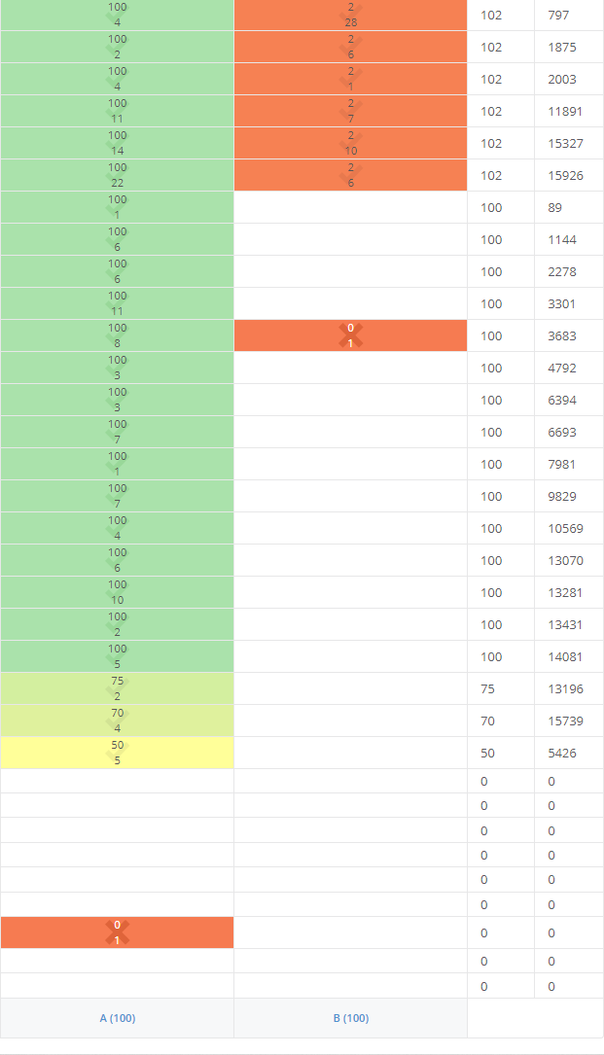
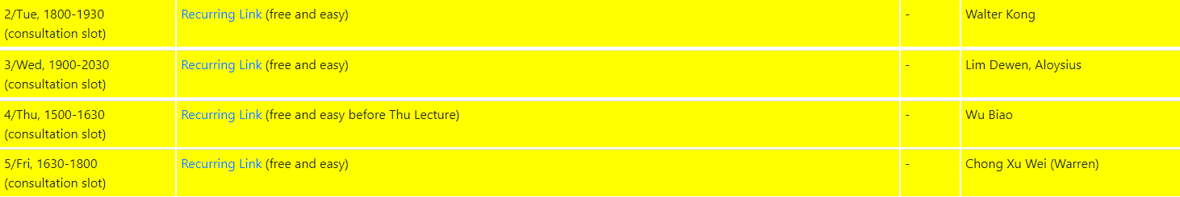
Admins : PS1 Issues…
The picture on the left is PS1 situation on Wed, 01 Sep 2021, 9.45am SGT, about 3 days to deadline…
If you need help, do PS1 together with TA guidance (in high level) below
Do NOT take shortcuts, i.e., plagiarise

Slide 4
Review of Sorting (PS1) + Basic LL, so far
The details of sorting (the theoretical part) will be asked in midterm/final but the applications of sorting is the one that is tested in PS1 and possibly in PE
Quick analysis of https://nus.kattis.com/sessions/vpw8rg (PS1 A+B, last high-level ideas)
https://visualgo.net/en/sorting?slide=1-2 should have been discussed in Tut/Lab02
Quick review of https://www.comp.nus.edu.sg/~stevenha/cs2040c/demos/SLLDemo.cpp

Slide 5
Linked List, review of basic Stack
https://visualgo.net/en/list?slide=4 to 4-7
Q&A on Basic Stack stuffs:
Extending SLLDemo.cpp/py/java to SLLtoStack.cpp/py/java (local copy)
Introducing C++/Python/Java Class OOP principle: inheritance
Not really examinable, just FYI
C++ std::vector/Python list/Java ArrayList for Stack ADT?
Choices to be elaborated further:
Postfix Calculator, .e.g., Kattis – circuitmath
If you are interested: Infix-to-Postfix shunting-yard algorithm
Bracket Matching, e.g., Kattis – delimitersoup
Kattis – evenup
Notes:
Done live, we extend class SLL to class MyStack, we will see this again soon with SLL to class MyQueue and later extending BST class to AVL Tree class
Quick answer: Possible, use its back side as the top side :O
Next few slides, the choice depends on majority of students’ need

Slide 6
Postfix Calculator
Infix (Our Default) | Postfix (Reverse Polish) | Result
2 + 6 * 3 | 2 6 3 * + | 20
( 2 + 6 ) * 3 | 2 6 + 3 * | 24
Can we evaluate a Postfix expression in O(N)?
Notes:
Yes, with help of a stack (initially empty)
Do one pass, read the expression from left to right, O(n)
If we encounter an operand, we will push it to the stack
If we encounter an operator, we will pop the top two items of the stack, do the required operation, and then put the result back to the stack
Return the top (the only item) of the stack as the final answer

Slide 7
Evaluate: 2 6 3 * +
First: push(2) | Second: push(6) | Third: push(3) | Fourth: Process * | Fifth: Process +
 |  | 3
 | 6 | 6 | 18
2 | 2 | 2 | 2 | 20

Slide 8
Kattis – evenup
Sample Input 2
1 | 3 | 3 | 4 | 2 | 4 | 1 | 3 | 7 | 1 | 4
1/0 for odd/even, respectively; even+even or odd+odd produces an even result
1 | 1 | 1 | 0 | 0 | 0 | 1 | 1 | 1 | 1 | 0
Notes:
S2 AY2018/19 (reused in S1 AY2021/22)
To get even sum, we need to sum two even numbers or two odd numbers, we can ignore the actual numbers and just put 1 for odd numbers and 0 for even numbers
We can remove two adjacent 11 or 00, in any order actually (but slow if you do so, especially the requirement for ‘closing the gap’, remember than n is 100 000)
But the easiest order is to process from left to right with a stack, somewhat similar to Bracket Matching

Slide 9
[Optional in S1 AY21/22, weak TC] Kattis – thegrandadventure
If Jim encounters Money ($), Incense (|), or Gem (*), he puts it into his backpack one after another
If Jim encounters a Banker (b), Trader (t), or a Jeweler (j), he needs to give Money, Incense, or Gem, respectively
Jim’s backpack is a…
Stack (Last In First Out/LIFO style)
Simulate this Jim’s “linear adventure”
Jim’s backpack must be empty at the end for a successful adventure

Slide 10
Linked List, review of Queue ADT
https://visualgo.net/en/list?slide=5 to 5-6
Q&A on Basic Queue ADT stuffs:
Do you “agree” that SLL is one of the best data structure to implement this basic Queue ADT?
Extending SLLDemo.cpp/py/java to SLLtoQueue.cpp/py/java (local copy)
To be explored at home by yourself:
Seems N/A ☺, but consider application of Queue ADT?
Notes:
SLL allows dynamic expansion and shrinking, it never need to rearrange vertices; it has O(1) performances for enqueue and dequeue operations that are needed for Queue ADT; but if you understand “more” you will realize that you can actually implement an efficient Queue (enqueue and dequeuer in O(1)) using 2 Stacks (2 Vectors) too :O… (the resizeable circular vector idea also possible but slightly harder to implement).
Done (not) live, to show that this is also “easy”, but with O(N) version to showcase SLL implementation that does not have tail pointer. After S1 AY2021/22 lecture, Steven eventually extend his code to SLL with tail pointer to achieve true O(1) InsertAfterTail performance and will likely edit VisuAlgo e-Lecture slides involving SLL for future semesters
Optional:
We will revisit the super important application of Queue ADT later when we learn Breadth-First Search (BFS) graph traversal algorithm in the second half of the class

Slide 11
Linked List, review of Doubly LL
https://visualgo.net/en/list?slide=6 to 6-2
Q&A on Doubly LL stuffs:
What are actually changed between SLL and DLL? This (addition of prev(ious) pointer for every vertex), This (the crucial and now efficient remove tail), and This (the others)
Ensure that you fully understand the “remove tail problem” of SLL
To be explored at home by yourself:
Appreciate the trade offs between SLL and DLL
Notes:
Ensure that you understand all those tiny differences, especially the RemoveTail operation from O(N) in SLL to O(1) in DLL… and the fact that we now need to take care of the correctness of prev pointers for all vertices too
It is O(N), and we usually want O(1) performance too (for pop_back)
Others:
What is the advantage of SLL compared to DLL? What can DLL do but SLL cannot? What are the ‘drawbacks’ of using DLL instead of SLL? Is that a big deal?

Slide 12
Linked List, review of Deque ADT
https://visualgo.net/en/list?slide=7 to 7-1
Q&A on Basic Deque stuffs:
It is basically a “weakened Deque”, but C++ STL std::deque is using “something else” to achieve O(1) random access performance
To be explored at home by yourself:
[Optional] Kattis – integerlists (CS2040C S1 AY2017/18 optional midtest Q)
Any other rare application of Deque ADT?
Lastly, after seeing all these variations of a simple LL concept, you may want to explore other variations of LL implementations, Google around…
Notes:
CS2040C only: Surprise: C++ STL std::deque is not actually implemented with DLL… Somewhat a chain of fixed arrays (details outside the scope of this module). In Python, we use deque for Queue as Python list is just a resize-able array with weak pop(0) / removeHead. In Java, see ArrayDeque (https://docs.oracle.com/javase/9/docs/api/java/util/ArrayDeque.html)
Others:
Clever usage of ‘both sides’ of the list, with help of Deque ADT (std::deque or even std::list).
Left as exercise for interested readers
Try adding/removing head/tail pointers, try adding circular link from tail to head, etc…

Slide 13
Let’s do this ‘simple’ VA OQ part
https://visualgo.net/training?diff=Medium&n=5&tl=0&module=list
This module needs more creative/harder/challenging automatically generated questions…

Slide 14

Flipped Classroom Continued
PS2 (which is out this weekend) should now be doable with what you have learned so far
You are allowed to use C++ STL to solve PS2
But for extra challenges (for top students who will find PS2 ‘easy’), try coding “your own version of STL list/stack/queue/deque” (or whenever needed) to further strengthen your understanding about these data structures (a few RTEs/WAs are expected)
By tomorrow (Thursday, 02 Sep 2021), you all should have started reading the next topic
https://visualgo.net/en/heap?slide=1 to at least slide 6

Slide 15
Binary Heap, review of Priority Queue ADT
https://visualgo.net/en/heap?slide=1 to 1-10
Q&A on Basic PQ ADT stuffs:
PQ in-class live demo
Do you understand why the other two data structures that we have learned so far: array/vector and linked list (whatever variants, sorted or not) are not good to be used for efficient PQ implementation?
To be explored at home by yourself:
N/A
Notes:
Only applicable for live class, the Avianca Flight 52 or LaMia Flight 2933 (Chapecoense football club tragedy)
Either the enqueue or the dequeue is “slow”, in O(N)
Optional:
N/A

Slide 16
Binary Heap, review of Binary Heap basic
https://visualgo.net/en/heap?slide=2 to 2-2
Q&A on Basic Binary Heap structure:
Discussion of Complete Binary Tree and Binary Max Heap
Bye bye “linear world” of array/vector and linked list (whatever variants)
Or “not”, as we actually still use compact array to internally implement Binary Heap :O
The O(log N) Insert(v) and O(log N) ExtractMax()
There you go, a possible efficient PQ ADT implementation ☺
To be explored at home by yourself:
N/A
Notes:
Quick review of Complete Binary Tree and Binary Max Heap property
Quick review of O(log N) insert and O(log n) extractmax that will be used for PriorityQueue operations
Optional:
N/A

Slide 17
Next e-Lecture for our Flipped Classroom
By next Wednesday, 08 Sep 2021, 10am, you must have read https://visualgo.net/en/heap?slide=7 until … the end :O
Super duper lost otherwise…

